Slide 1
Project management for retail & industrial construction projects
The Zimbabwean Experience
8 November 2019

Slide 2
Project management for retail & industrial construction projects
The focus on this presentation will be to a large extend on experience gained with Retail Projects for Ok Zimbabwe and Industrial plants for Delta.
Talk will centre on :
The Role of the Project Manager
Tender Procedures
Contract administration
Client Focus
Demands on the Project Manager- Supply Chain Challenges
Conclusion

Slide 3
Retail & Industrial Projects
The Retailer :
Most projects for the retail sector have focused on upgrading existing supermarkets to current trends in Southern Africa.
Emphasis has been on refurbishing shops without closing them and where necessary to close for systems change over this is done over a few days.
The Industrialist:
New Equipment coming in complete from Europe
Decommission existing equipment and alter buildings to fit new equipment.
Civil works have to be done as equipment is being shipped and installation happens on arrival avoiding any double handling and loss of production.

Slide 4
The Role of the Project Manager
Regard himself as an extension of the client team – to protect the client’s interests and ensure the team delivers on time/quality/cost.
On Appointment he must:
Collect and Confirm the Brief
Recommend the appointment of the professional team
Develop the scheme design with the team and get client approval
Develop initial budget for works – within 10 to 15% accuracy (USD) get client approval
Initial programme for design/approvals/tender/construction and handover date.
Confirm go ahead with client and proceed with detail design.
At Tender:
Recommend list of contractors – minimum 6
Prepare full tender documentation and issue to invited Tenderers
Tender site visit for tenderers
Arrange to receive tenders
Adjudicate on the tender with professional team and issue tender report.
Recommend contractor/s for appointment and get client go ahead.
Contract Award :
Notify successful tenderer and also advise the unsuccessful ones (help them retire their bid bonds)
Issue letter of intent and get contractor’s acceptance of offer (legally binding formal offer and acceptance.)
Draw up construction contract and ensure its signed.
Kick off meeting
Prepare Project Plan & Gantt Chart.

Slide 5
Tender Procedures
Clients being Blue Chip listed companies require a transparent tender and contractor appointment.
Pre-qualified Tender list approved by Client
Tender on:
Full Dwgs & Specifications
Full BoQ and Tender Instructions
Compulsory Tender Site Visit
Bid Deliverables :
Full priced BoQ (normally in Duplicate)
Bid and Price Validity Period
TIME FRAME
Warranty
Proposed Specialist Sub Contractors
Attachemnts:
Tax Clearance
Company Reg Docs
NSSA clearance
SAFETY MGT PLAN
BASIC PRICE LIST
WORK EXPERIENCE
PROGRAMME
METHOD STATEMENT
KEY PERSONNEL
FINANCIAL STMT & BANK REFERENCE

Slide 6
CONTRACT KICK OFF
Project is initiated when owner and contractor enter into contract or agree to start work with LOI – owner becomes client
Project Initiation Steps :
1. Review precontract documents – check the technical & commercial proposals
2. Establish Client communication channels – PM must maintain project control
3. Hold client kick off meeting – make sure there is total agreement!
4. Prepare project plan
5. Issue Project Documents(Dwgs, Specs etc)
6. Prepare project co-ordination procedure
7. Confirm project budgets and cashflows
8. Review engineering plans
9. Review Procurement plan with Contractor
10. Review Construction Plan
As soon as the contract has been awarded, the PM begins to race against time as the leader of the team to procure and hand over the finished Project.

Slide 7
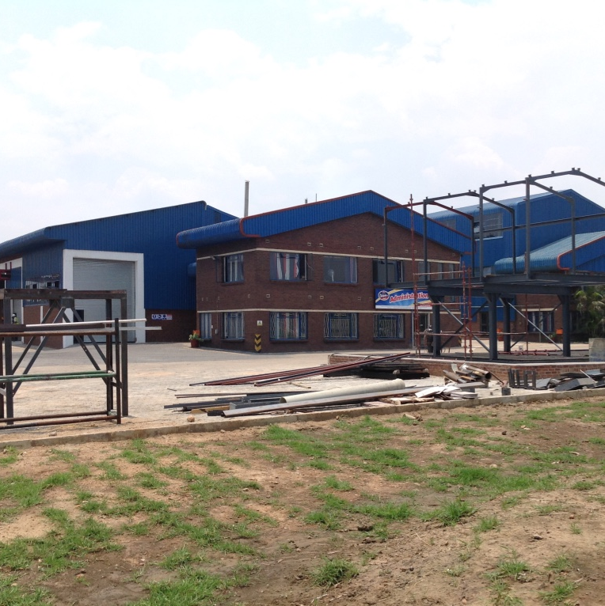
Contract Administration –managing the procurement process
Successful Projects require that the PM is hands on throughout the project life Cycle:
Monthly Management Meetings – include client
Site Meetings – Progess updates/minutes/sub cntrctors mtgs
Design Co-ordination Meetings
Quality Control – regular site visits
Finacial Control – Valuations, Variations, Claims etc
6. Practical Completion – defects liability /final certificates/delays & extension of time/major disputes.

Slide 8
Client Focus
Retail Client
Local Authority approvals in place
Handover Date cant move – relates to shop opening – fixed.
Occupation certificate in place – affects shop licences (butchery/liquor etc)
Industrial Client
Local Authority approvals in place
Equipment installation and access
Completion date – affects first production date which is normally fixed.

Slide 9
Demands on the Project Manager – Supply Chain Challenges & Solutions
The PM must deliver the Project on Time, to the expected Quality and within Budget.
This he will do by working with the Construction team, The Consultants and the Client.
The challenge is to engender Collabrative working for the team in a highly fragemented environment with adversarial attitudes.
Achieving budgets in our volatile environment demands that the PM convinces upfront funding and pre-purchasing of construction materials, reduced delays in honouring certificates. Contractor must be flexible to allow direct payments to suppliers by the client.
PM must still in control and goes the extra mile in the Procurement Process.

Slide 10
Thank you
Eng joas Musoko
Projects director
  engmusoko@gmail.com

